Slide 1
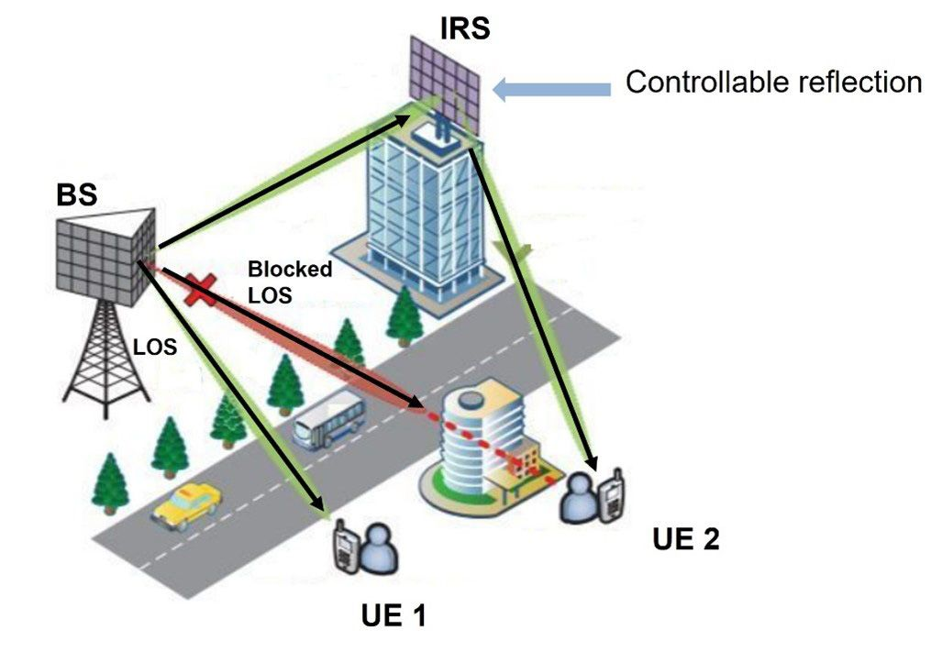
6G Communication Architecture Compared with the OSI Model
Sivadharshini.K-192524008
Dharshana.D-192524243
Sub: Computer Networks

Slide 2
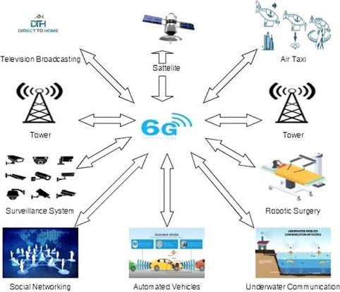
Introduction
6G is the next generation of wireless communication expected around 2030.
It aims to provide data rates up to 1 Tbps and extremely low latency.
6G integrates Artificial Intelligence (AI), Edge Computing, and Terahertz communication.
The OSI model provides a framework for understanding network communication processes.

Slide 3
OSI Model Overview
The OSI model consists of seven layers:
Physical Layer – Transmission of bits.
Data Link Layer – Error detection and medium access control.
Network Layer – Routing and logical addressing.
Transport Layer – Reliable end-to-end communication.
Session Layer – Establishes and manages sessions.
Presentation Layer – Data formatting and encryption.
Application Layer – Provides services to users.
Purpose: Standardizes communication between different network systems.

Slide 4
6G Communication Architecture
Major Components of 6G:
User Equipment (Smartphones, IoT devices, Sensors)
Radio Access Network (RAN)
AI-Native Network Controller
Core Network
Edge and Cloud Computing
Application and Service Layer
Objective: Intelligent, autonomous, and ultra-fast communication.

Slide 5
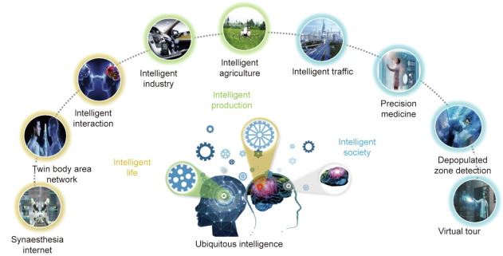
Advantages of 6G
Extremely high data rates
Better spectrum utilization
Intelligent resource management
Support for holographic communication
Improved user experience

Slide 6
Key Features of 6G
AI-Native Network Architecture
Data rates up to 1 Tbps
Latency below 1 ms
Massive machine-type communication
Edge intelligence and cloud integration
Enhanced security and privacy
Support for digital twins and immersive applications

Slide 7
Comparison Between 6G and OSI Model
Feature | OSI Model | 6G Architecture
Type | Reference Model | Communication Architecture
Layers | 7 Layers | Multiple Functional Components
AI Integration | Not Available | Built-in AI
Communication | General Networks | Wireless Networks
Flexibility | Fixed Structure | Dynamic and Adaptive
Purpose | Standardization | High-speed Intelligent Communication

Slide 8
Conclusion
The OSI model provides a layered approach to communication.
6G architecture performs the functions of OSI layers while introducing AI and intelligent networking.
Technologies such as THz communication, network slicing, and edge computing make 6G more advanced than previous generations.
6G is expected to revolutionize future communication systems and smart applications.
Thank You

Slide 9
THANK YOU

